Slide 1
Hospital Management System
MD.Fuadul Islam(16313555042)
MD.Seragis Salekin(1632228042)
Farzia Chowdhury(1522115642)
Faculty: Intisar Tahmid Naheen(ITN)
Section: 12

Slide 2
The Website will be created
Foreground
1.HTML
2.CSS
3Bootstraps
Background:
1.JavaScript
2.PHP
3.SQL

Slide 3
Name | Frontend Week 1 | Frontend Week 2 | Backend | Backend
Farzia | Patient Admission Form | Medical Advise by the Specialist Form
Salekin | Patient Admission Receipt Form | Doctors Information Form
Fuad | Patient Investigation Form | Nurses Information Form,Medicine Entry Form

Slide 4
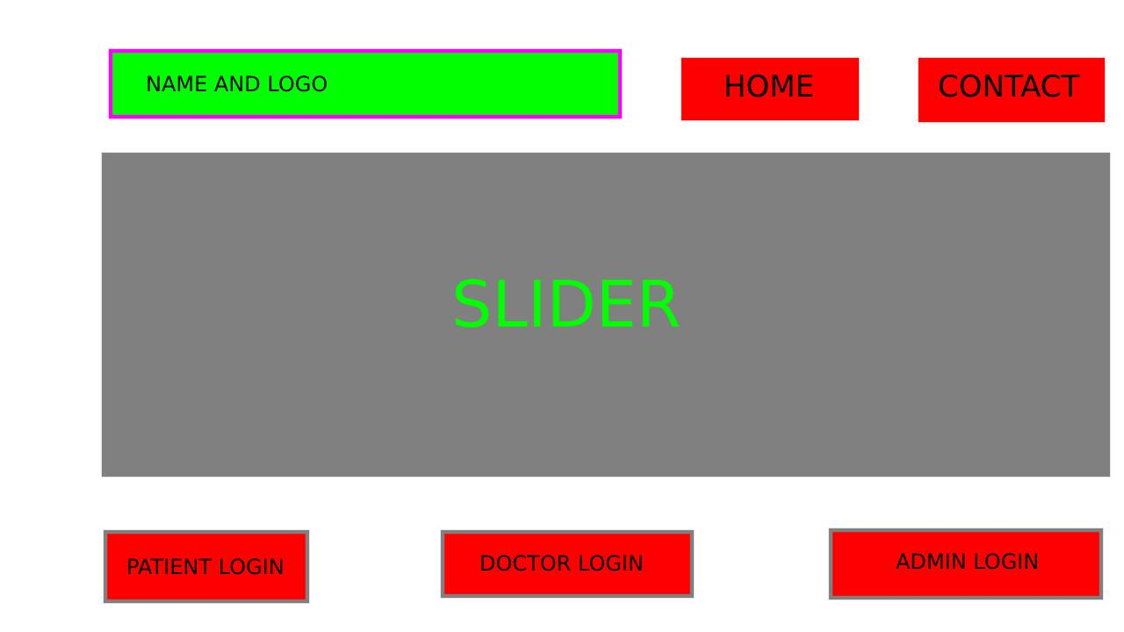
Website Fronted Design Using Photoshop

Slide 5

Gang Chart

